Slide 1
Vision-Based Technology for Automated App Testing
Presenter: Wei-Lin Chang
Advisor: Prof. Farn Wang

Slide 2
Outline
Introduction
Background
Framework
Experiment
Conclusion

Slide 3
Outline
Introduction
Background
Framework
Experiment
Conclusion

Slide 4
Introduction
Graphical user interfaces (GUIs)
Allow users to interact with hardware in user friendly ways
Challenges for GUI Testing
Exploration on input interaction space
Manually found by test engineer
Automatically derived from platform API
Automated approaches based on platform API
No information for external components
Not cross-platform

Slide 5
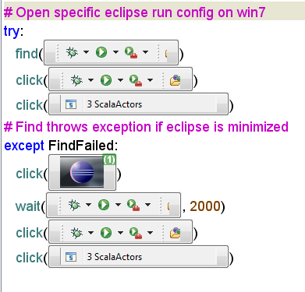
Related Work Sikuli
Sikuli is a tool to help test engineers write test scripts with images they see. [1]
Some similar tools : eggPlant 、Ranorex and so on.

Slide 6
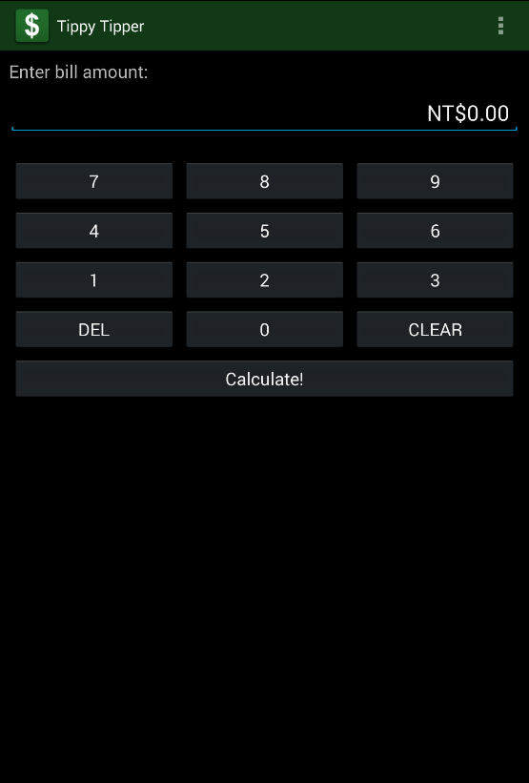
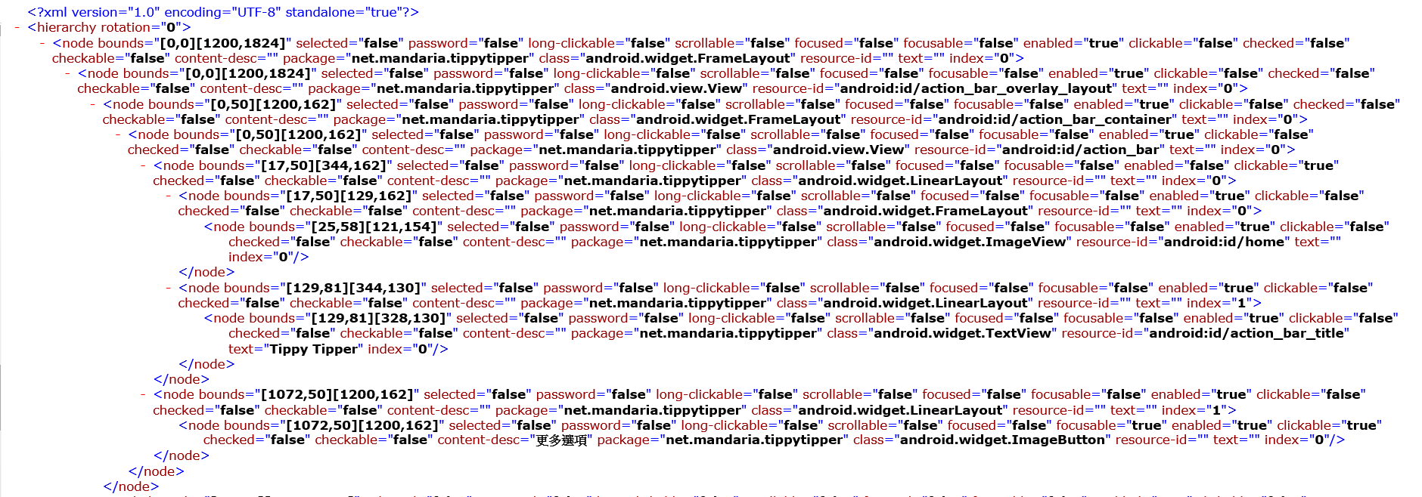
Related Work Android UI Automator
UI Automator is a tool provided by Google to get the information of UI components on the screen. [2]
Record the information with XML format.

Slide 7
Related Work MobiGUITAR
MobiGUITAR is an automated model-based testing tool for Android apps. [3]
Build the behavior model of application under testing (AUT) with information from UI Automator
Automatically generate test cases with the model

Slide 8
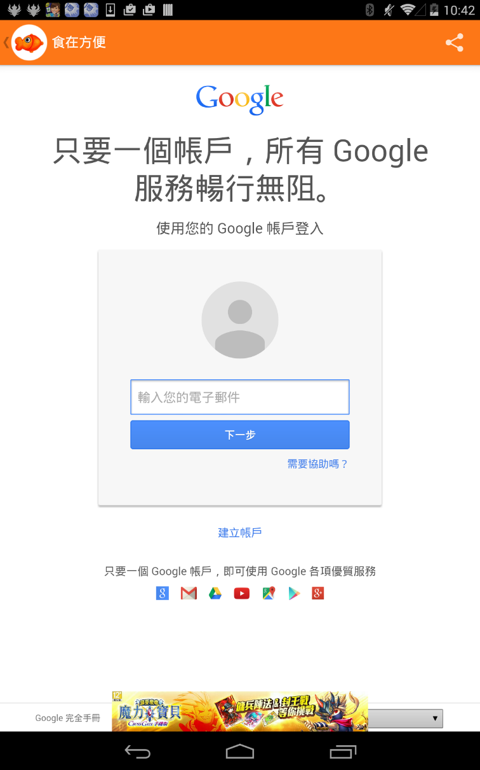
Motivation Challenges of External Component
External Components:
Internal browser
Internal Google Map
Unity

Slide 9
Purpose
Develop a GUI testing tool
Handle external components
Cross-platform
With Computer Vision

Slide 10
Outline
Introduction
Background
Framework
Experiment
Conclusion

Slide 11
Background Computer Vision
Thresholding
With the grayscale image, we can use thresholding to create a binary image.
Adaptive threshold [4]
Estimate local threshold value for each pixel
T(x,y) is the mean of N*N neighborhood of (x,y) - constant C
Provided by OpenCV

Slide 12
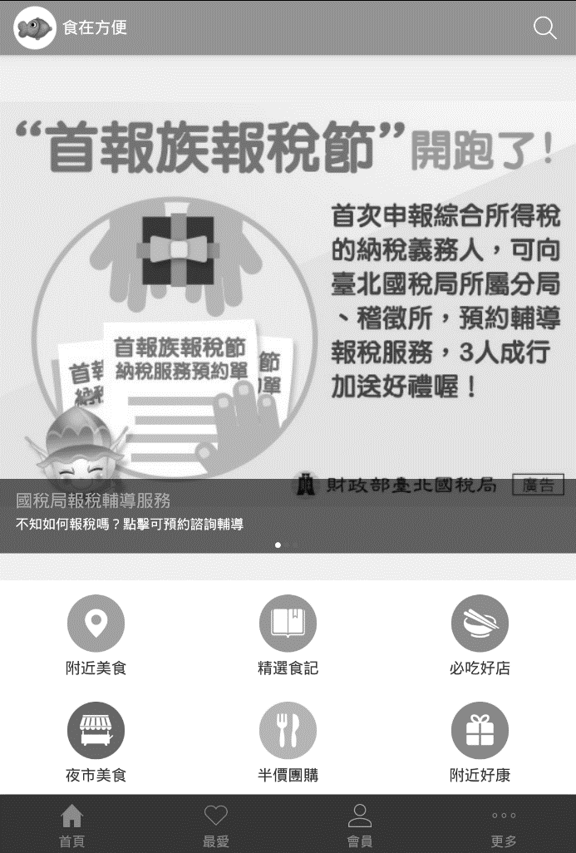
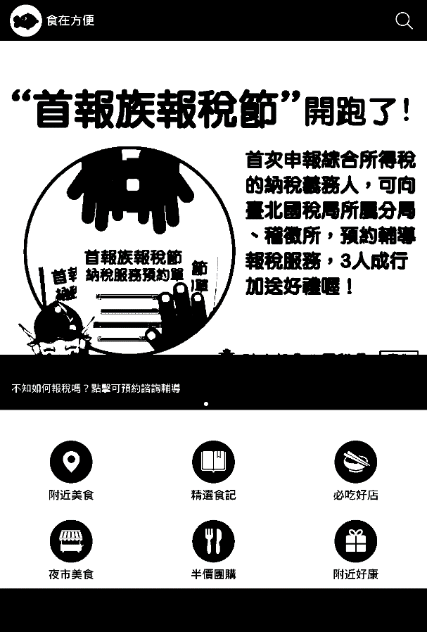
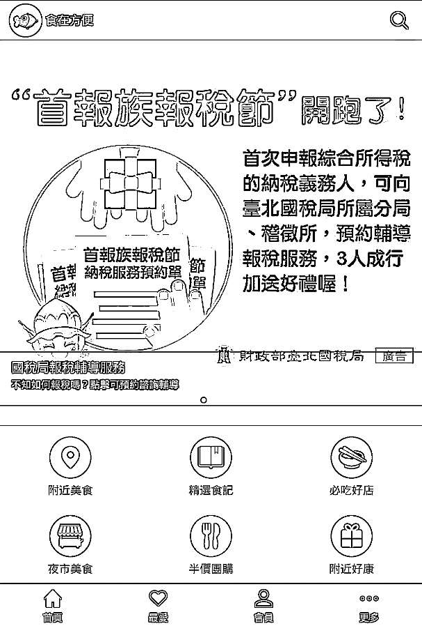
Background Adaptive threshold
The best image using global thresholding method still loss some information, but adaptive not
Origin
Global threshold value :190
Adaptive

Slide 13
Background Model Based Testing
Model the desired behaviors of Application Under Testing (AUT) with finite-state machine
State: abstract screenshot
Transition: action (e.g. a click event)
Depth first exploration
Test cases can be generated based on the model

Slide 14
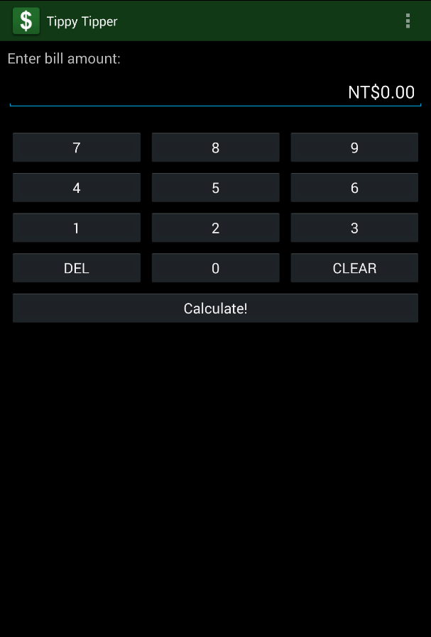
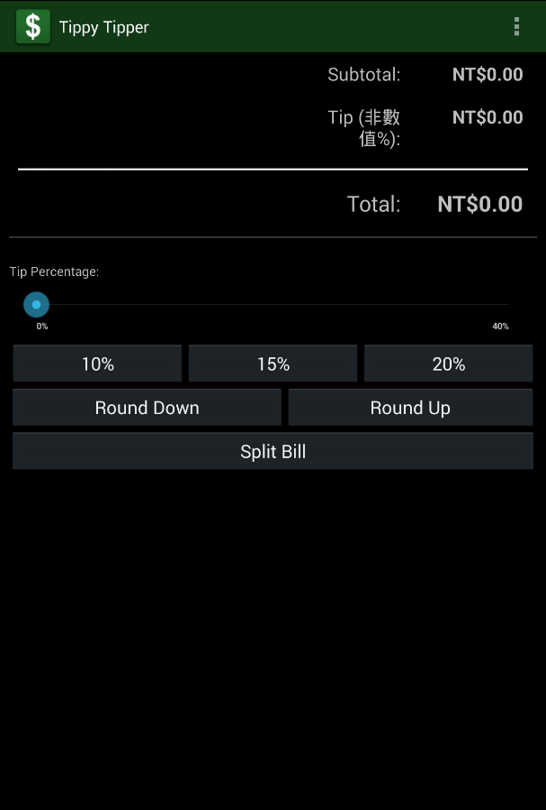
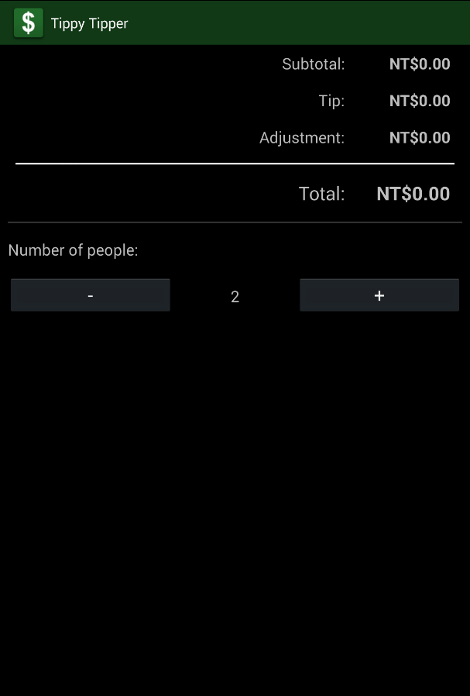
Background Instance of model

Slide 15
Outline
Introduction
Background
Framework
Experiment
Conclusion

Slide 16
Overview
Exploration
AUT
AUT Model
Rectangle
Recognition
Screenshot
Abstraction
Simplification (Transition Merging)
Reduced AUT Model

Slide 17
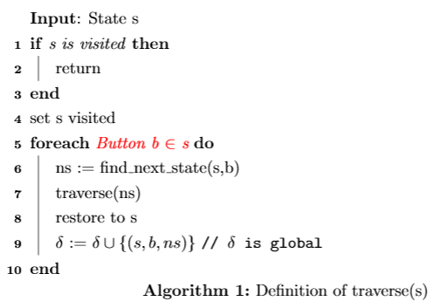
Exploration Common Depth First Exploration
Where are the buttons?

Slide 18


Rectangle Recognition Assumption on buttons
Buttons are composed of closed contours

Slide 19


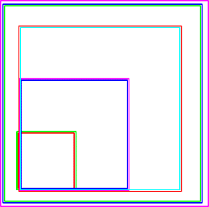

Rectangle Recognition
Convert RGB to B/W
Find Contours
Calculate
Bounding
Rectangles
Merge by Geometry
Build Hierarchy of Rectangles
XML

Slide 20
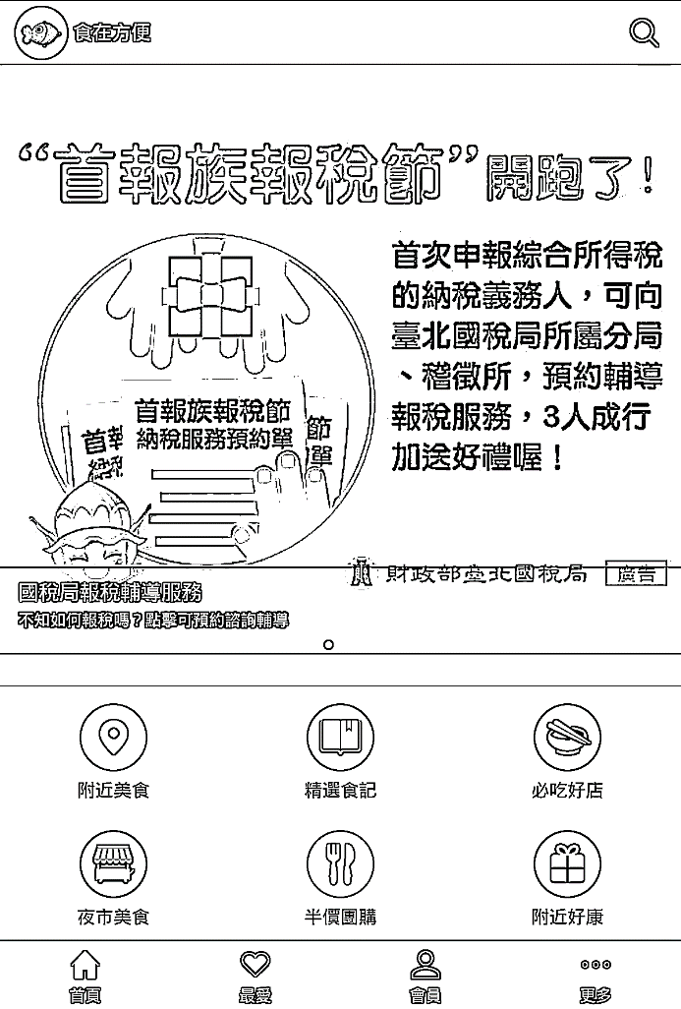
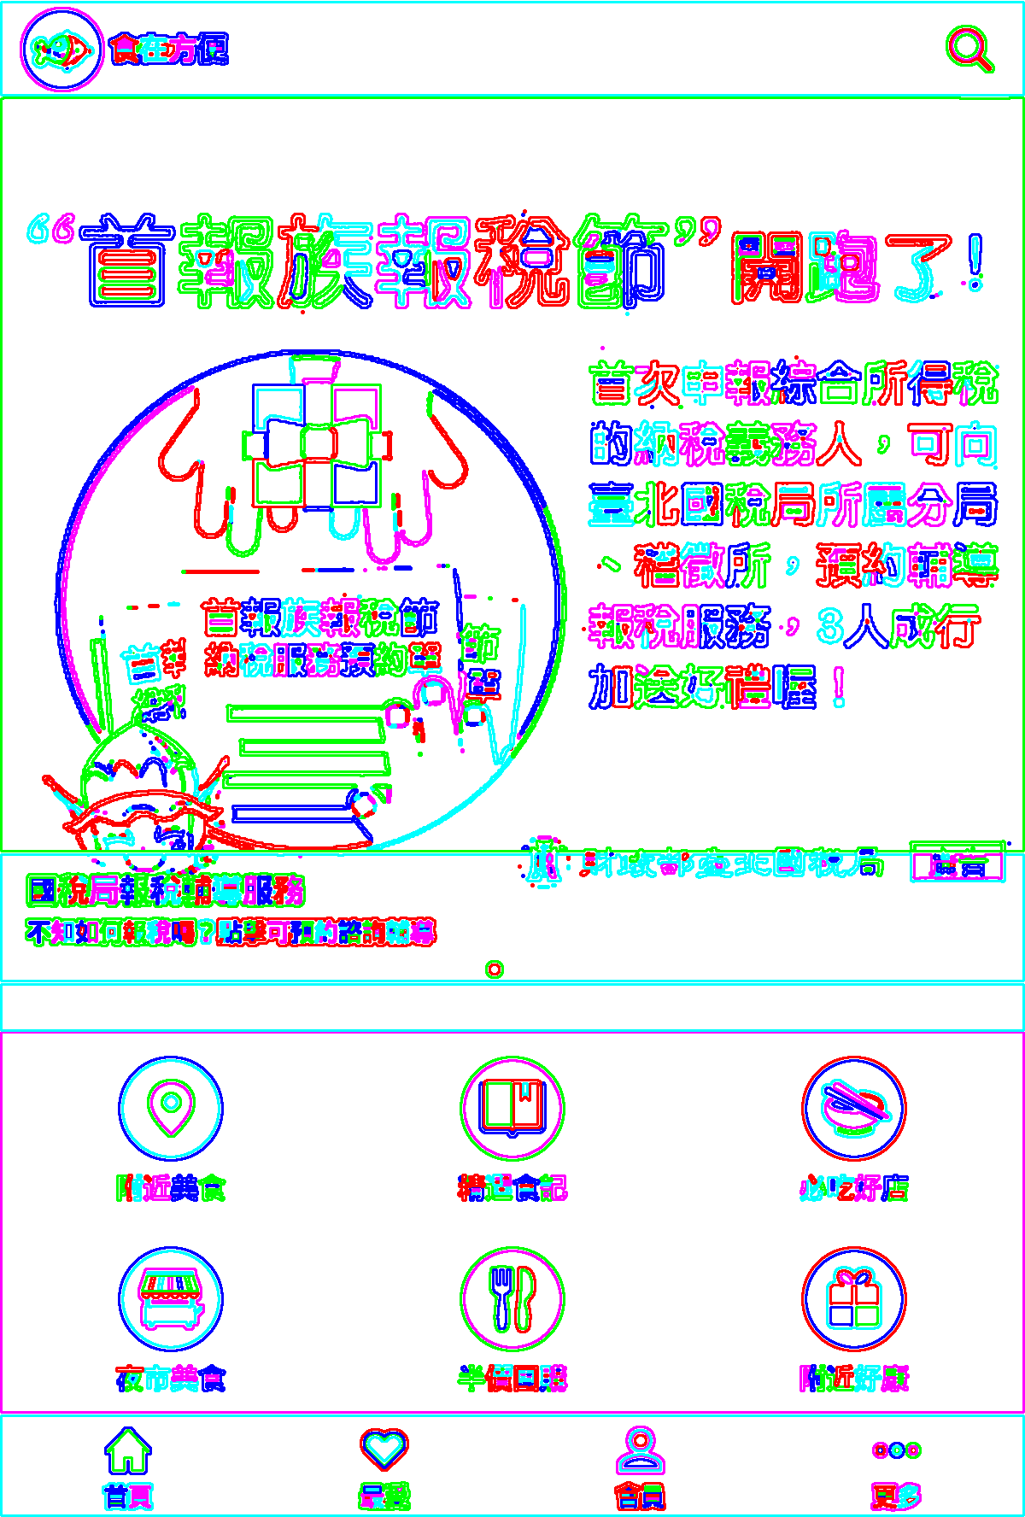
Rectangle Recognition Find out all Contours

Slide 21

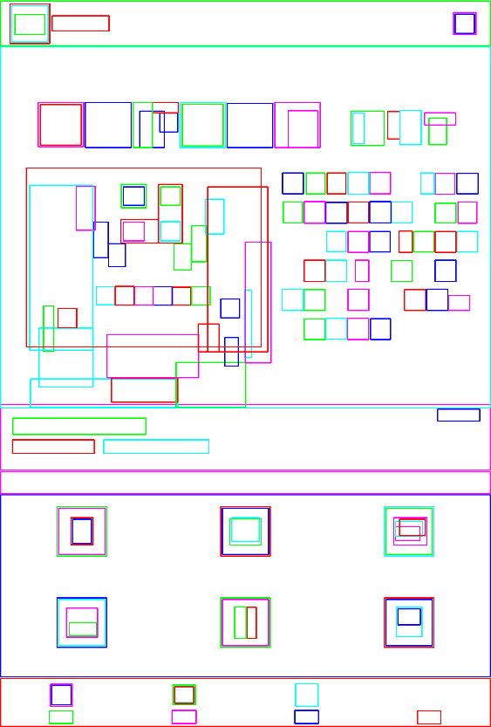
Rectangle Recognition Calculate Bounding Rectangles
Reshape each contour with its bounding rectangle
Remove rectangles smaller than fingertips

Slide 22
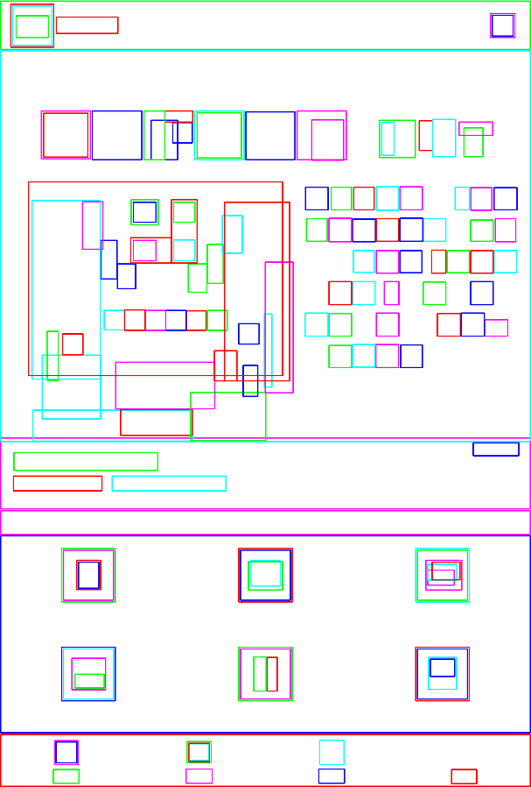
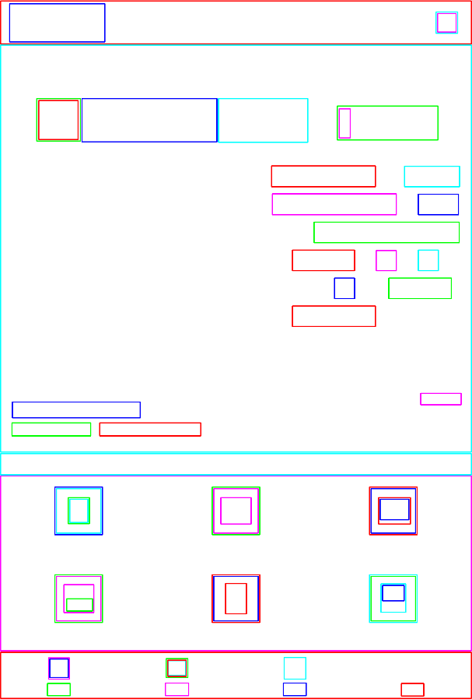
Rectangle Recognition Merge by Geometry
Heuristically merge rectangles which are partially overlapping with each other but keep the completely overlapping rectangles.
142 rectangles
61 rectangles

Slide 23
Rectangle Recognition Build Hierarchy of Rectangles
Transform rectangles to tree structure

Slide 24
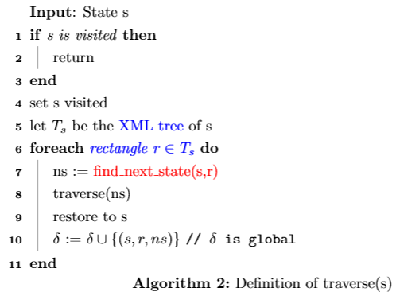
Our Depth First Exploration
Use rectangles as possible buttons
How to find next state without the complete model?

Slide 25
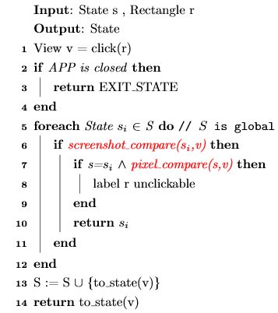
Screenshot Abstraction find_next_state

Slide 26



Screenshot abstraction pixel_compare
Determine if two views are the same
A
B
pixel_compare(A,B)

Slide 27
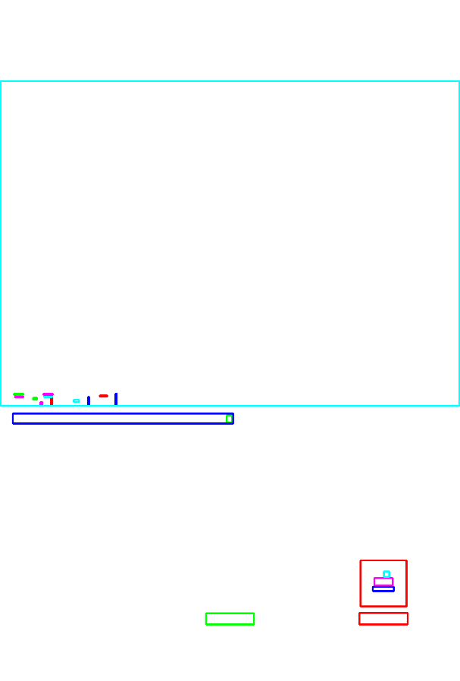
Screenshot abstraction screenshot_compare
Part of view not related to AUT behavior (e.g. ADs)
Heuristically tolerate at most 1 large rectangles

Slide 28
Overview
Depth-First Exploration
AUT
AUT Model
Rectangle Recognition
Screenshot
Abstraction
Simplification (Transition Merging)
Reduced AUT Model

Slide 29


Simplification Transition Merging
Some buttons contain several different rectangles
Merge these rectangles with the same response

Slide 30
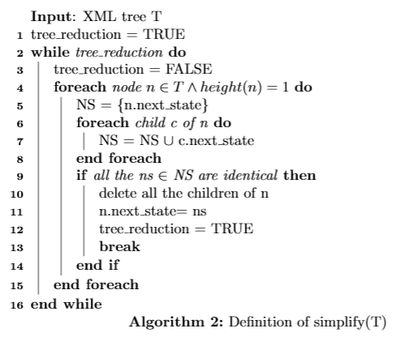
Simplification Simplify function

Slide 31
Outline
Introduction
Background
Framework
Experiment
Conclusion

Slide 32
Experiment Environment
CPU : AMD X4 750K @ 3.4GHz
Ram : 8 GB
OS : Windows 8.1 64Bit
Mobile platform : Asus Nexus 7 (2013)

Slide 33
Experiment Design
Verify the recognition rate of buttons on the screenshot
The total buttons are count by manual

Slide 34
Experiment Benchmark
Tippy Tipper
雙鐵時刻表
食在好行

Slide 35
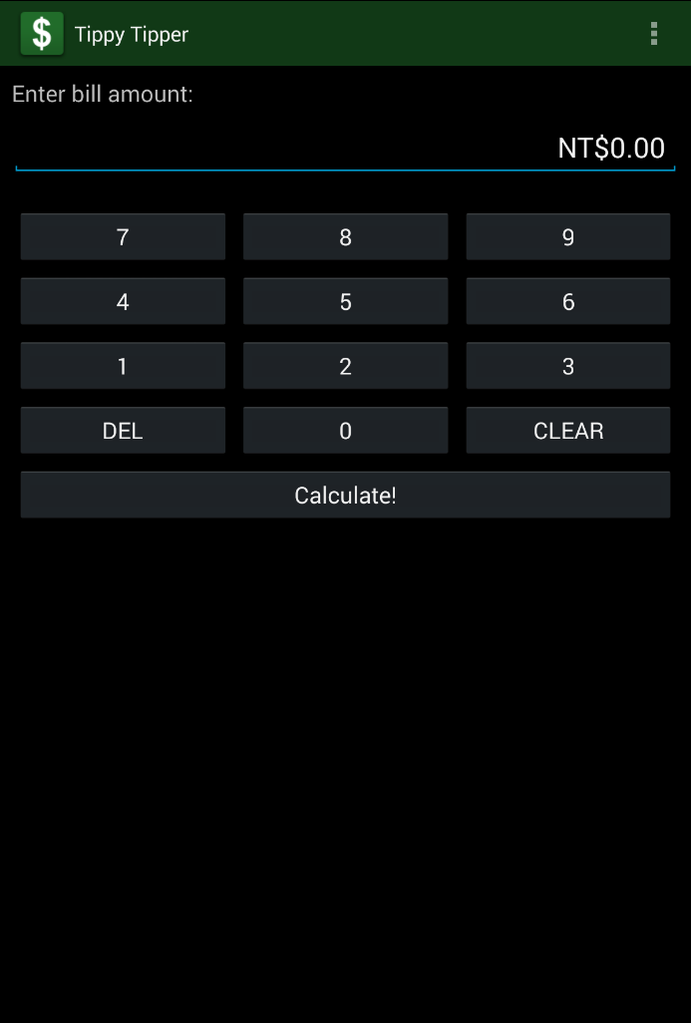
Experiment Tippy Tipper
Name | Tippy Tipper
Downloads | 100,000~500,000
Rating | 4.6
Publish Date | 2013/12/16
Provider | Mandaria Software

Slide 36
Experiment Result of Tippy Tipper
 | Recognized |  |  | Unrecognized
Total buttons | Clickable | Unclickable | Inaccurate bounds | Noise
23 | 22 | 1 | 0 | 0
Recognition Rate of Clickable : 95%
Recognition Rate : 100%

Slide 37
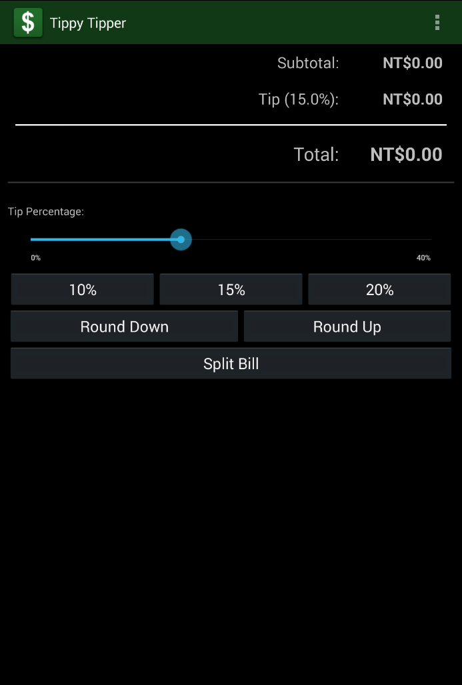
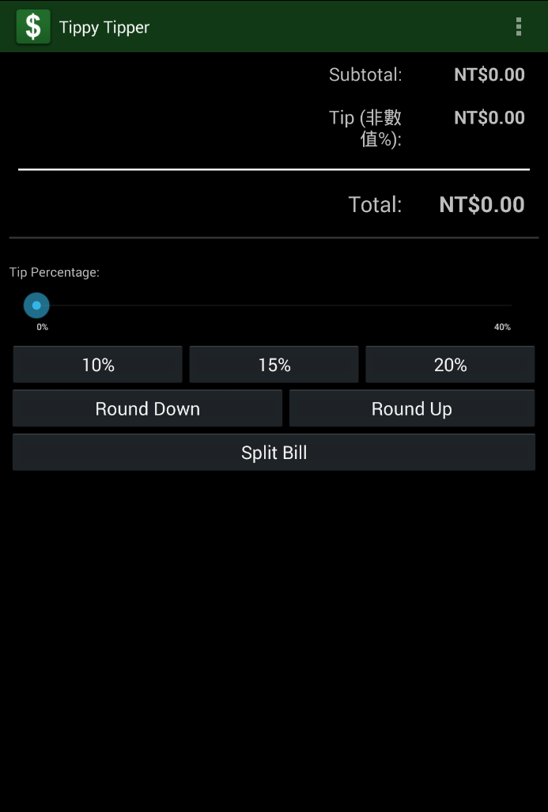
Experiment Challenge of Abstraction

Slide 38
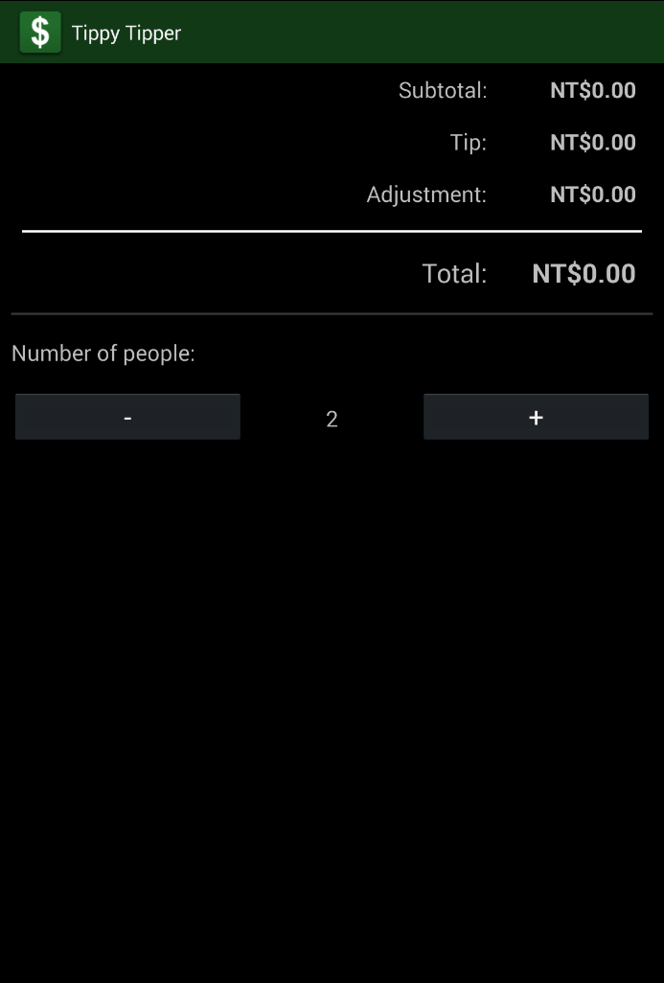

Experiment Challenge of Unclickable

Slide 39
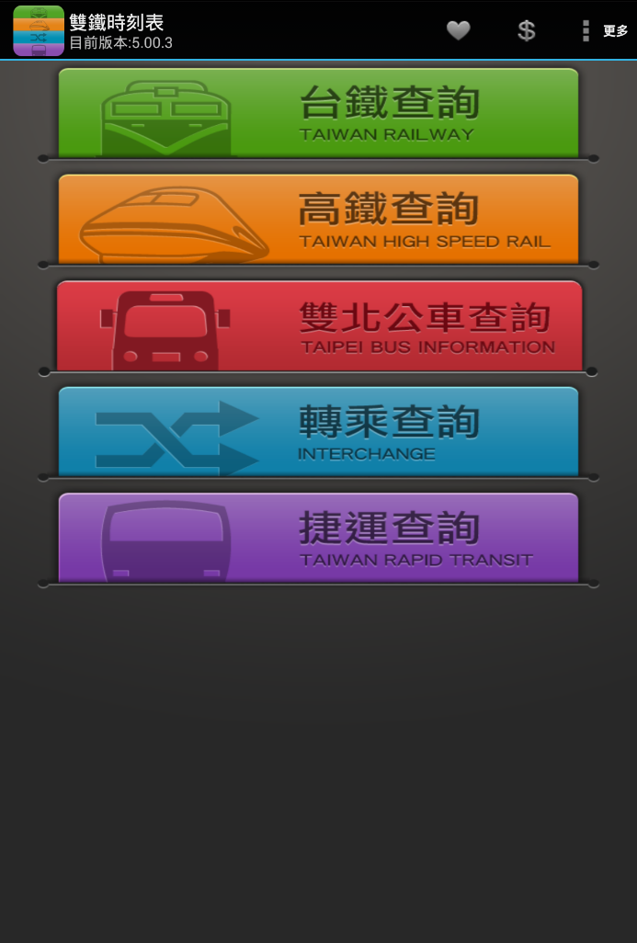
雙鐵時刻表
Name | 雙鐵時刻表
Downloads | 100,0000~500,0000
Rating | 4.6
Publish Date | 2015/7/6
Provider | Xavier Wu

Slide 40
Experiment Result of 雙鐵時刻表
 | Recognized |  |  | Unrecognized
Total buttons | Clickable | Unclickable | Inaccurate bounds | Noise
74 | 55 | 11 | 6 | 2
Recognition Rate of Clickable: 74%
Recognition Rate : 97%

Slide 41
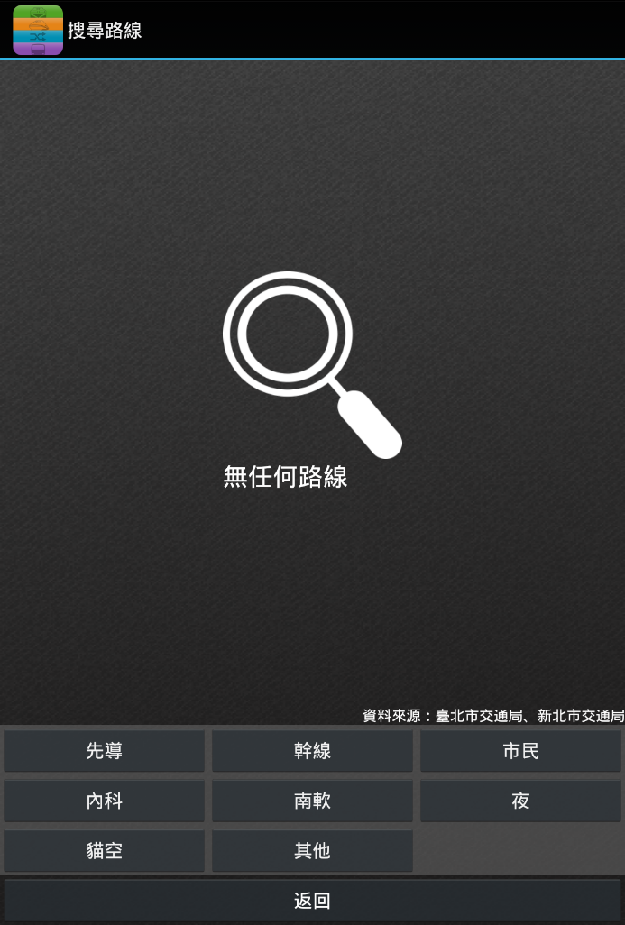

Experiment Challenge of Inaccurate bounds

Slide 42

Experiment 食在方便
Name | 食在方便
Downloads | 1,000,000~5,000,000
Rating | 4.6
Publish Date | 2015/7/1
Provider | OrangeFish

Slide 43
Experiment Result of 食在方便
 | Recognized |  |  | Unrecognized
Total buttons | Clickable | Unclickable | Inaccurate bounds | Noise
159 | 115 | 2 | 3 | 39
Recognition Rate of Clickable: 72%
Recognition Rate : 75%

Slide 44
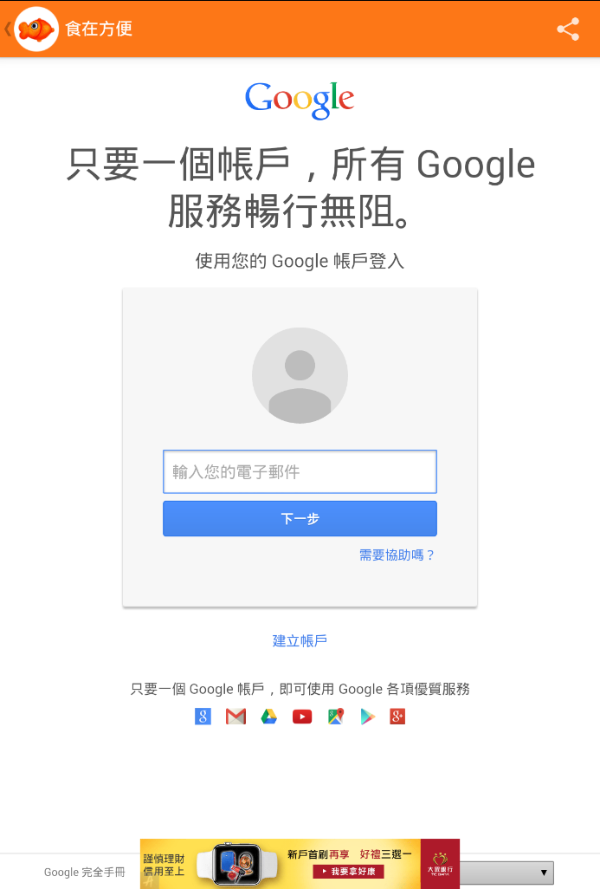

Experiment Handle external components

Slide 45
Outline
Introduction
Background
Framework
Experiment
Conclusion

Slide 46
Conclusion
The tool can handle external components
ADs are our huge challenges
Recognition rate of clickable is at least 72%

Slide 47
Future work
Improve view abstraction with different computer vision techniques
Increase recognition rate of clickable by using different algorithms to collect transitions
Increase recognition rate by adjusting noise threshold dynamically
Get more information by OCR(Optical character recognition)

Slide 48
Q&A

Slide 49
Reference
[1] T.-H. Chang, T. Yeh, and R. C. Miller, “GUI testing using computer vision,” Proc. 28th Int. Conf. Hum. factors Comput. Syst., no. Figure 1, pp. 1535–1544, 2010.
[2] “UI automator.” [Online]. Available: https://developer.android.com/tools/testing-support-library/index.html.
[3] D. Amalfitano, A. R. Fasolino, P. Tramontana, B. Ta, and A. Memon, “MobiGUITAR -- A Tool for Automated Model-Based Testing of Mobile Apps,” IEEE Softw., pp. 1–1, 2014.
[4] R. L. Kirby, “A Note on the Use of (Gray Level, Local Average Gray Level) Space as an Aid in Threshold Selection,” IEEE Trans. Syst. Man. Cybern., vol. 9, no. 12, pp. 860–864, 1979.
[5]T. Azim and I. Neamtiu, “Targeted and Depth-first Exploration for Systematic Testing of Android Apps,” ACM SIGPLAN Conf. Syst. Program. Lang. Appl. Softw. Humanit., pp. 641–660, 2013.

